Slide 1
Restaurant Inspection Survey Results
MARCH 7, 2012

Slide 2
Letter Grade System
In July 2010, New York City instituted the letter grading system, requiring food service establishments to post letter grades corresponding to their sanitary inspection scores.
Letter Grade | Points
A | 0-13
B | 14-27
C | 28+
Notes:
New York City is home to 24,000 restaurants. In July 2010, the Department of Health and Mental Hygiene or “DOH” began requiring restaurants to post letter grades to reflect scores for violations from sanitary inspections to be clearly visible to the public.
An inspection score of 0-13 violation points is an ‘A’, 14-27 violation points is a ‘B’, and 28 or more violation points is a ‘C’ grade. Points one could accumulate, based on the different condition levels, is out of a possible 1,256.

Slide 3
Frequency of Inspection
Initial Inspection
0-13
Points
28+
Points
14-27
Points
1 Year
Re-Inspection
Re-Inspection
5-7 Months
3-5 Months
Notes:
The Health Department conducts several types of inspections to monitor sanitary conditions.
Inspection of New Restaurants is conducted before a restaurant opens for the Health Department to determine whether to issue a permit. This process is not graded. Once a restaurant is permitted to open, and shortly after it has begun operating, DOH will
conduct graded inspections.
Every restaurant is scheduled for an unannounced initial inspection at least once a year. A restaurant that scores 0 to 13 violation points on this inspection receives an A grade.
How often a restaurant will be inspected and how soon it will be re-graded, depends on the restaurant’s initial sanitary inspection or a consumer complaint. If a restaurant does not earn an A on its initial inspection, it is not graded and the Department conducts an unannounced second inspection about a month later. If the restaurant continues to not receive an “A” grade on their inspection, DOH will continue to inspect. Restaurants with more violations points are inspected more frequently than restaurants with fewer violation points.
If a restaurant does not receive an A on its initial inspection, it does not receive a grade until it receives a re-inspection. The re-inspection will occur at least one week after the initial inspection, giving the restaurant a chance to improve its sanitary conditions. At the end of the re-inspection, the restaurant will receive a grade card. If the grade is an A, the card must be posted immediately. If the grade is a B or C, the restaurant will also receive a card that says “Grade Pending.” The restaurant has the choice of immediately posting the Grade Card or the Grade Pending card until it has a chance to be heard at the Health Tribunal.
A restaurant that receives 28 or more points on a re-inspection will receive a “compliance inspection,” roughly 30 days after the re-inspection. The Health Department will continue to conduct compliance inspections roughly every 30 days until the restaurant scores under 28 points or is closed by the Health Department. Compliance inspections are not graded.
With each inspection, a restaurant could be subject to fines.

Slide 4
Restaurant Inspection Survey Results
January 10, 2012, the New York City Council released its Restaurant Inspection Survey
Administered online and in hardcopy
Offered in 7 languages
1,297 survey participants
Participants completed the survey in English, Spanish, Italian, Chinese & Korean
Survey participants representing all 5 boroughs
Manhattan 650
Brooklyn 264
Queens 166
Staten Island 63
Bronx 32
Notes:
As a response to a wave of complaints Speaker Quinn and Council Members received, in January 2012, the New York City Council released an informal survey to gather more information. This anonymous survey is not scientific. Rather, it was issued to provide feedback regarding DOH’s process in a forum where participants could be candid. That said, more than 300 felt strongly enough about the issue to provide contact information for further Council questioning.
Today’s presentation will only highlight some of the responses from the survey. A full analysis of the restaurant survey can be found in the briefing paper which is available at the back of the room.
This informal survey was available online and in hardcopies. It was offered in seven languages. A link to the online survey was available on the New York City Council website. Nearly 1,300 restaurants responded to the survey, and it was completed in five languages. The Council received survey participation from restaurants in all five boroughs.

Slide 5
Restaurant Demographics
Notes:
As you can see from the restaurant demographics we received a mixed of establishments. There was diversity of restaurants in regards to gross annual sales and sizes.

Slide 6
Current Letter Grade
Notes:
The make up of survey recipients represented, roughly mirrors the city-wide distribution of restaurant letter grade. In our survey, we received 67 percent of As, 14 percent of Bs, 1.3 percent of Cs and 17 percent of grade pending. DOH’s data sample showed as of January 2012, 67 percent of restaurants have A, 14 percent were Bs, 3 percent Cs and 16 percent of restaurants have grades pending

Slide 7
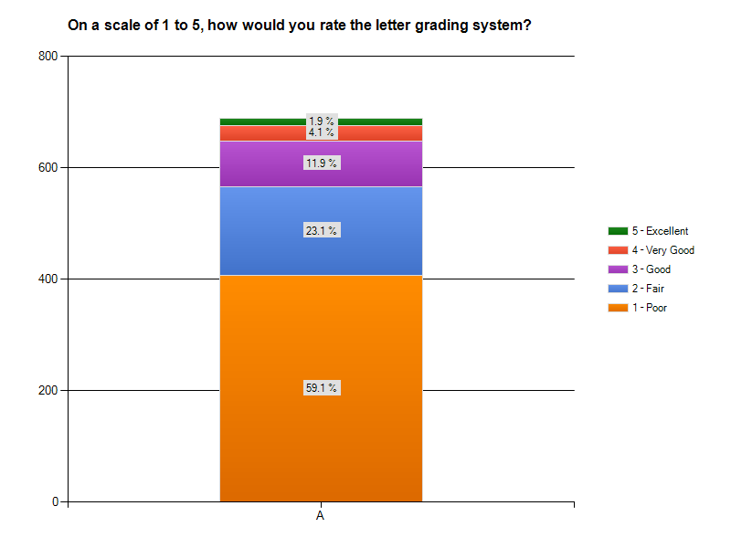
Viewpoints Rating the Letter Grade System
Viewpoints of “A” Restaurants
Notes:
To gauge how restaurants view the new letter grade system, participants were asked to rate the system on a scale from 1 to 5, 1 being poor and 5 being excellent. We received over 1,000 responses to this question and the majority, at 65 percent, rated the grading system as poor.
It is not just the B and C restaurants that found the letter grade system to be poor. In fact, nearly 60% of restaurants who currently have an A grade rated the system poor.
Participant responses to open ended questions may shed some light to this decision. Participants said that the inspections were inconsistent, adversarial relationship with DOH, and believing the Administrations views them as a revenue generator for the City.

Slide 8
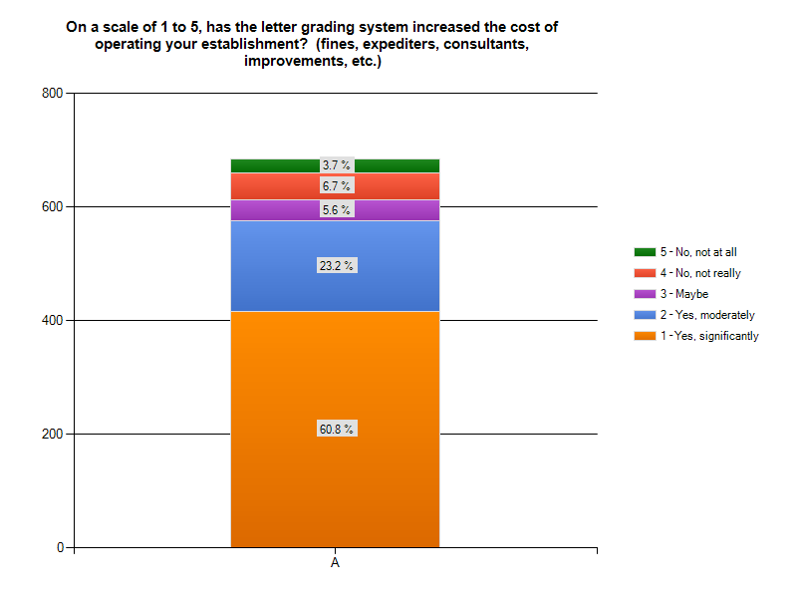
Viewpoints Increased Costs
Viewpoints of “A” Restaurants
Notes:
By and large restaurants have noted seeing a hike in the cost of operating an establishment since implementing the letter grade system. 87 percent of respondents indicated the letter grading system has increased their cost, with 68 percent of those individuals seeing a significant increase in operating a restaurant.
Since the letter grade system, participants are increasingly likely to spend money on consultants to prepare for inspections and to pay expeditors to contest fines in court.

Slide 9
Viewpoints Interactions with DOHMH
Professionalism of Inspectors
“Have the inspector treat the business owner fairly and with respect.”
Relationship with DOHMH
“I feel scared [to contact DOHMH], they have the power and can make your life a misery. So why bother.”
Communication with DOHMH
“I didn't know that I can contact DOHMH.”
“Generally, we have to leave several messages before someone gets back to you sometimes weeks later. Or you have to go waste literally a half work day waiting to see someone at the office.”
Experience with DOHMH versus Health Regulators in Other Cities
“Yes, in Las Vegas, the Health Department is tough but act as your partner to ensure food safety. In New York they act like we’re the enemy.”
Notes:
Comments we have received from participants really spoke to the type of relationship restaurants have with DOH.
First, participants noted the professionalism of inspectors are poor. Restaurants share the same goal with DOH in wanting to improve the health and safety of restaurants, but want to achieve this goal in a consistent, fair and professional manner.
The dynamic or relationship between the DOH and restaurants, is widely described as adversarial. A number of participants stated they knew who to contact but did not because they feared retribution and some individuals attempted to contact someone at DOH but did not receive a responses.
Regarding communicating with DOH, by and large people did not know who to contact at DOH regarding questions, feedback or to make a formal complaint.
Participants were also asked if they operated food establishments in different jurisdictions and if so, how does their experience with the health and safety inspection process in New York compare to such processes elsewhere. 140 restaurants owners who stated owning an establishment in other cities describe their experience with other Health Departments as a cooperative and fair partnership. We received responses stating other Health Departments use a teaching model rather than a punitive one.

Slide 10
Viewpoints Sample Violations Believed to Have No Bearing on Health and Safety
Inadequate lighting
Employees drinking beverages
Plates/utensils improperly stored
Leaky faucets
Broken tiles
Open doors
Food Protection Certificate holder not present at beginning of inspection
Notes:
Time and time again, the Council heard restaurant owner criticize the system for penalizing restaurants for violations that have little or no direct bearing on health and safety. Some examples of such violations were being cited for employees drinking water or coffee during their shift, were given points for having a door open, when restaurants received food deliveries, violation points for plates being stored improperly or utensils not facing the same direction. Ultimately, these violations can cost a restaurant their A grade and hundreds of dollars.

Slide 11
Viewpoints Reform Recommendations
Improve the consistency of the inspections
Create a partnership between restaurants and DOHMH
Provide restaurants with an opportunity to make corrections on the spot
Reduce the amount of each fine
Notes:
Lastly, participants commonly suggested that all inspectors interpret the rules and apply them consistently.
Participants noted wanting a cooperative partnership with DOH instead of living in fear of them. Participants indicated wanting an inspection process that is base more on a teaching model rather than a punitive one.
Also, participants suggested minor violations, which can be corrected on the spot, should be given the opportunity to do so.
Finally, others said that the high cost of each fine has financially burden them and by lowering the cost will allow restaurants to continue to afford operating a New York City business.

